Slide 1
Everything You Need to Know as a First-Time Attendee
February 13, 2025

Slide 2
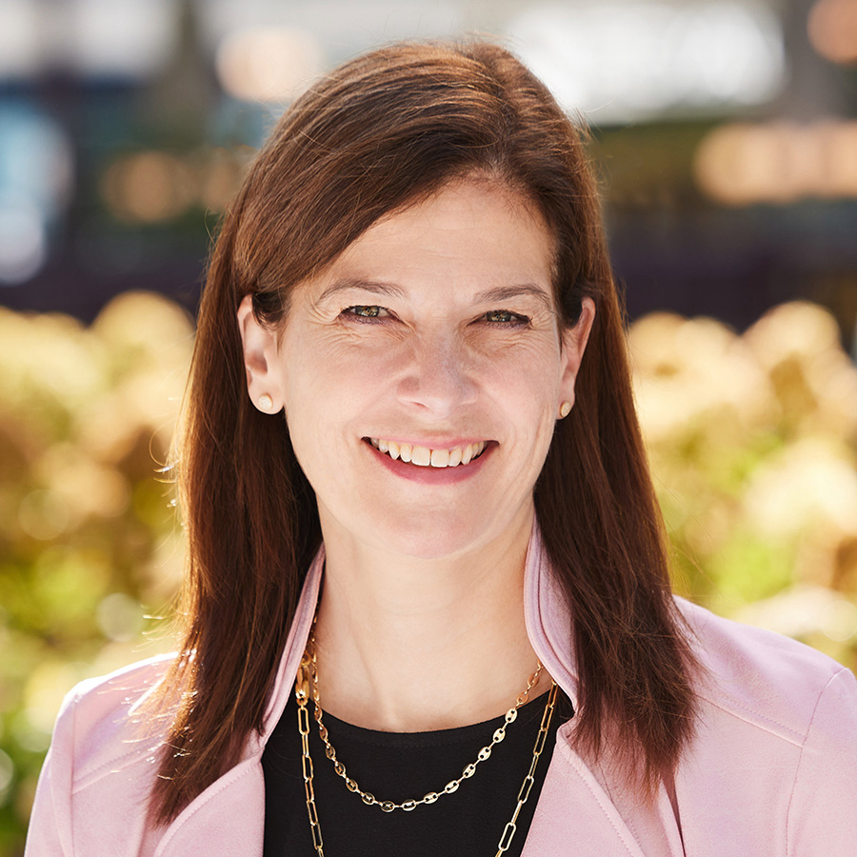
WELCOME!
Buffy Levy
Director, Shows
NAFEM

Slide 3
AGENDA
Welcome
Show Features
Onsite Details
Planning For Your Visit
While in Atlanta

Slide 4
NAFEM CHAT BOT

Slide 5
SHOW FEATURES

Slide 6
SHOW HOURS
Wednesday, Feb. 26 9 a.m. – 5 p.m.
Thursday, Feb. 27 9 a.m. – 5 p.m.
Training Time 8 a.m. – 9 a.m.
Friday, Feb. 28 9 a.m. – 3 p.m.
Training Time 8 a.m. – 9 a.m.

Slide 7
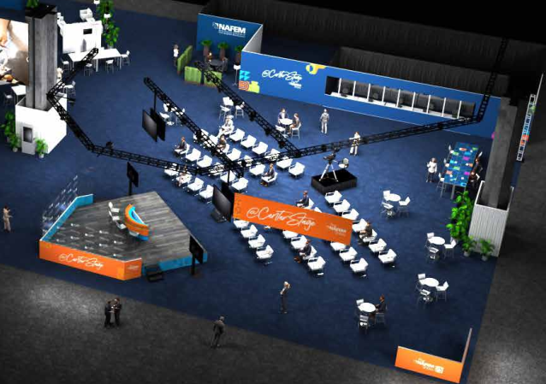
@CenterStage (Booth #6442)
Education centerpiece on the show floor that brings learning to life and empowers knowledge sharing throughout The NAFEM Show experience.
Spotlighted presentations about foodservice trends and topics featuring thought-leaders and industry icons.
Broadcast to other areas on show floor
Full schedule on mobile app and website

Slide 8
WHAT’S HOT! WHAT’S COOL!™ new product gallery (Booth 3520)
Booth #3520
Curated collection of E&S, highlightsing the industry’s latest advancements, all in one place
42 innovative products
Products new to industry since February 2023
Self guided – no exhibitor staff

Slide 9
WHAT’S HOT! WHAT’S COOL! ™ GUIDED TOURS
Take a guided tour on the show floor of the latest foodservice innovations. Open to operators, dealers and consultants.
Four total tours available (two per day)
Currently all tours sold out
Wednesday and Thursday from 10:30 a.m. – noon and 2 – 3:30 p.m. (90 minutes each)

Slide 10
U.S. CULINARY OPEN (Booth #6614)
The competition is an open format, allowing chefs to showcase their diverse styles of cuisine and their skills after years of training and cooking.
Chefs given three hours to execute three courses, five servings each (appetizer, vegetarian entrée, certified angus beef entrée)
Competition activities will be held over three days in Hall C: Booth #6614.
Feb. 26: Competition Day 1 (Two sessions per day)
Feb. 27: Competition Day 2 (Two sessions per day)
Feb. 28: Winners announced!

Slide 11
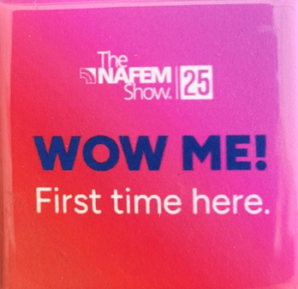
FIRST-TIMER ORIENTATION
@CenterStage
Wednesday, Feb. 26
9:45 – 10:15 a.m.
Meet other first-timers!
Pick-up your button at registration

Slide 12
CONNECTING WITH PRODUCTS/ EXHIBITORS OF INTEREST
Traditional badge scanning lead retrieval
Attendee-driven lead retrieval (ADLR)
Download the app

Slide 13
OTHER SPECIALITY AREAS ON EXHIBIT FLOOR
The NAFEM Booth (Booth #5940)
Headshot Lounge (Booth #4750)
Show Floor Lounges

Slide 14
TRAINING TIME
Thursday, Feb. 27
8 – 9 a.m.
Friday, Feb. 28
8 – 9 a.m.
Automatic Access
Channel: buying groups, consultants, dealers, service agents

Slide 15
NETWORKING OPPORTUNITIES
Kick-Off Party = $40/ticket
Tuesday, Feb. 25
GWCC Hall B1
6:30 – 8:30 p.m.
Purchase tickets through your registration dashboard

Slide 16
NETWORKING OPPORTUNITIES
NAFEM Party
Thursday, Feb. 27
Featuring OneRepublic
Mercedes Benz Stadium
Two ticket options
VIP Experience: SOLD OUT
7:00 – 11 p.m.
Concert-Only: $100
9 – 11 p.m.

Slide 17
ONSITE DETAILS

Slide 18
SHOW LOCATION
Georgia World Congress Center (GWCC)
285 Andrew Young International Blvd NW, Atlanta, GA 30313
B/C Buildings

Slide 19
BADGE PICK-UP
There are three locations to pick up your badge:
Airport – limited times
Take plane train to domestic baggage claim, head up escalators, next to Currency Exchange
Hotel – limited times (Signia By Hilton, Hilton Atlanta, Westin Peachtree Plaza, Atlanta Marriott Marquis only)
GWCC – Building B Registration Hall
Georgia Wold Congress Center
DAY | TIME
Tuesday, Feb. 25 | Noon – 8 p.m.
Wednesday, Feb. 26 | 7 a.m. – 5 p.m.
Thursday, Feb. 27 | 7 a.m. – 5 p.m.
Friday, Feb. 28 | 7 a.m. – 3 p.m.

Slide 20
HOTEL ACCOMODATIONS
Make hotel room reservations at thenafemshow.org
Rooms subject to availability and best available rate
Contact onPeak, at +1.855.203.6329 or NAFEM@onpeak.com

Slide 21
SHUTTLE BUS SERVICE
Shuttle Schedule
Tuesday, Feb. 25 11:30 a.m. – 9:00 p.m.
Wednesday, Feb. 26 6:30 a.m. – 5:30 p.m.
Thursday, Feb. 27 6:30 a.m. – 5:30 p.m.
Friday, Feb. 28 6:30 a.m. – 3:30 p.m.
Shuttle Logistics
Running every 20 minutes
Embassy Suites Centennial Olympic Park, Hilton Garden Inn, Hyatt Place Centennial Olympic Park, Omni and Signia by Hilton are all within walking distance to GWCC
The NAFEM Party – shuttles will run to all hotels apart from the SIGNIA by Hilton and the Omni.

Slide 22
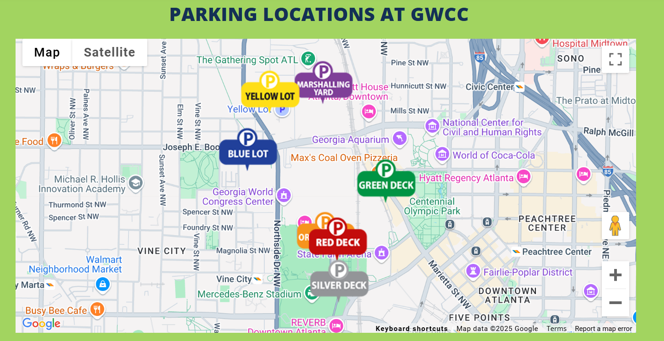
PARKING gwcc.parkingguide.com

Slide 23
RECCOMMENDED ATTIRE
Kick-Off Party (Tuesday) = casual
Show Floor (Wednesday – Friday) = business casual
The NAFEM Party (Thursday) = casual

Slide 24
FREE WIFI
Georgia World Congress Center
Show floor
All meeting rooms and public spaces
Network = 25NAFEM

Slide 25
HOSTED BUYER PROGRAM
Badge pick-up (airport, hotel or GWCC)
Badge + Networking Event tickets
Check in at Hosted Buyer Lounge – Room B214 (level 2)
Each show day, pick-up meeting card log to record meetings with exhibitors
Breakfast, lunch and snacks available daily in lounge
Lounge staffed by our concierge starting Tuesday, Feb. 25 at noon

Slide 26
HELPFUL HINTS
Wheelchairs/scooters
Wheelchairs available at GWCC Information Desks
Scooters through Mobility Georgia
Mobility/Georgia.com/conventions or +1.470.357.6130
Luggage check: B401
Mother’s room/wellness room:
Building B near escalator on Level 4
Building A across from Sidney Marcus Auditorium
Charging stations & wayfinders

Slide 27
PLANNING FOR YOUR VISIT

Slide 28
THE NAFEM SHOW APP
Mobile show app
Downloadable in Apple Store or Google Play
Used to navigate the show

Slide 29
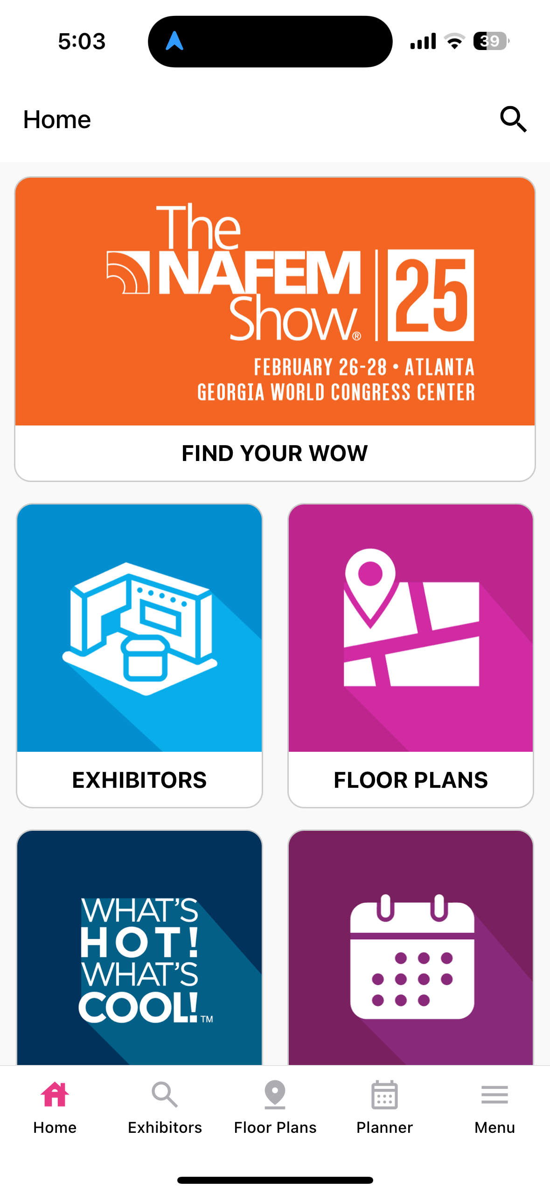
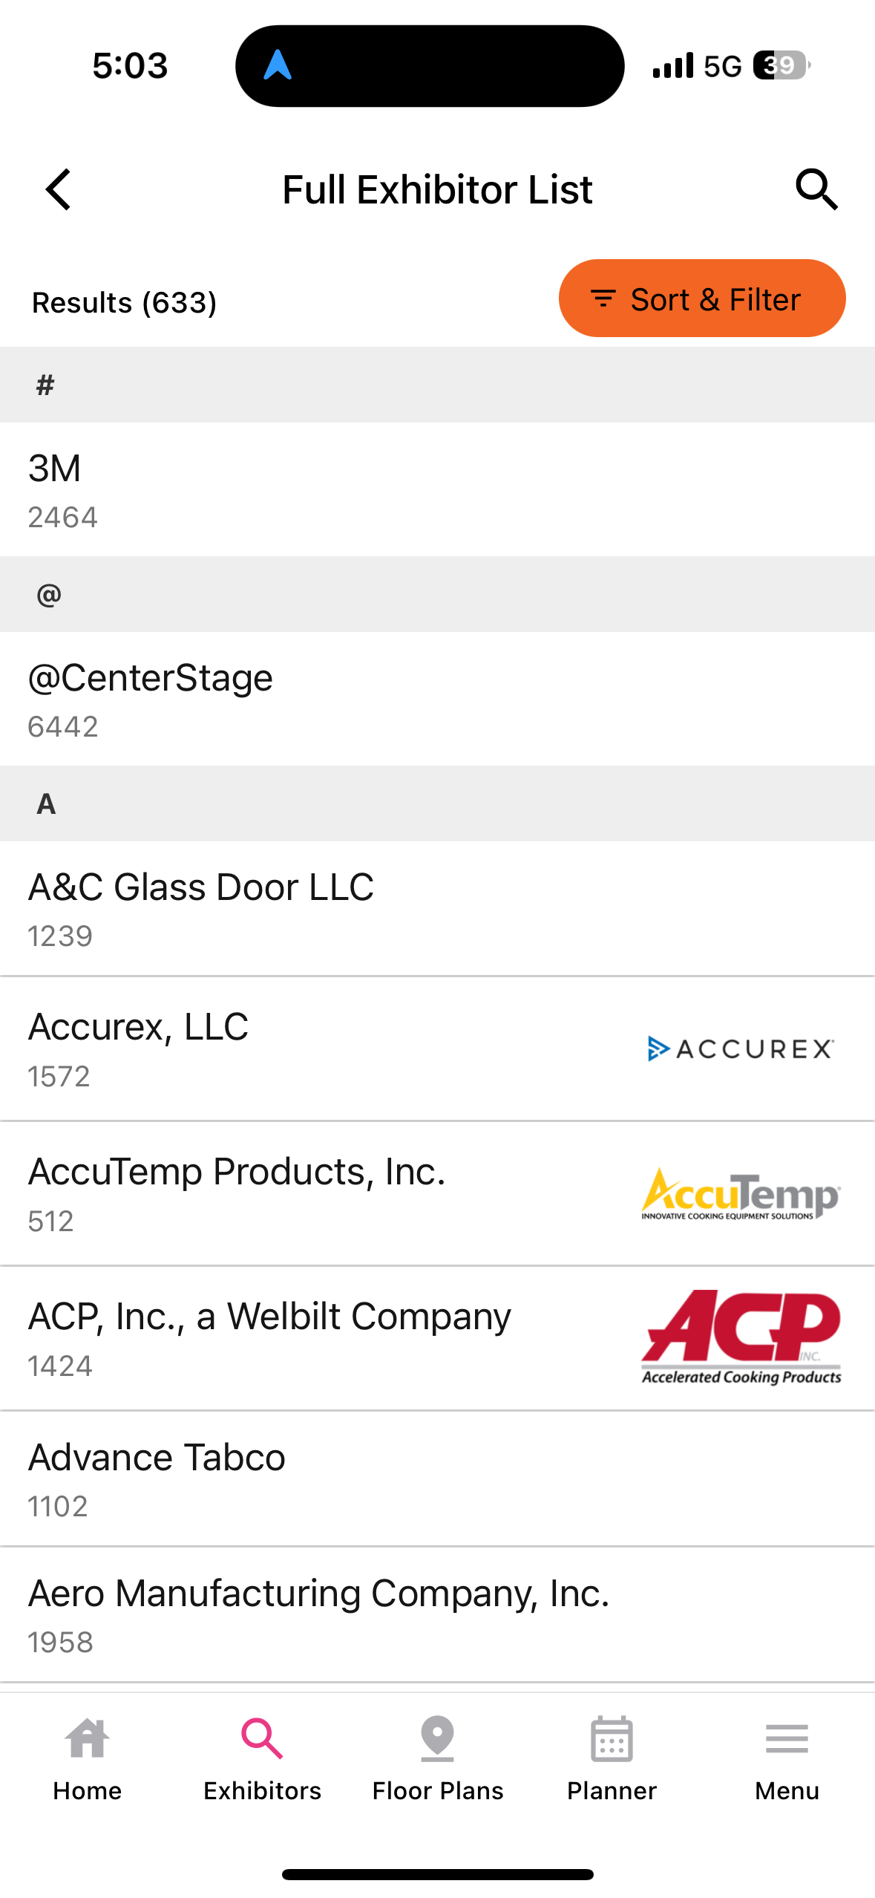
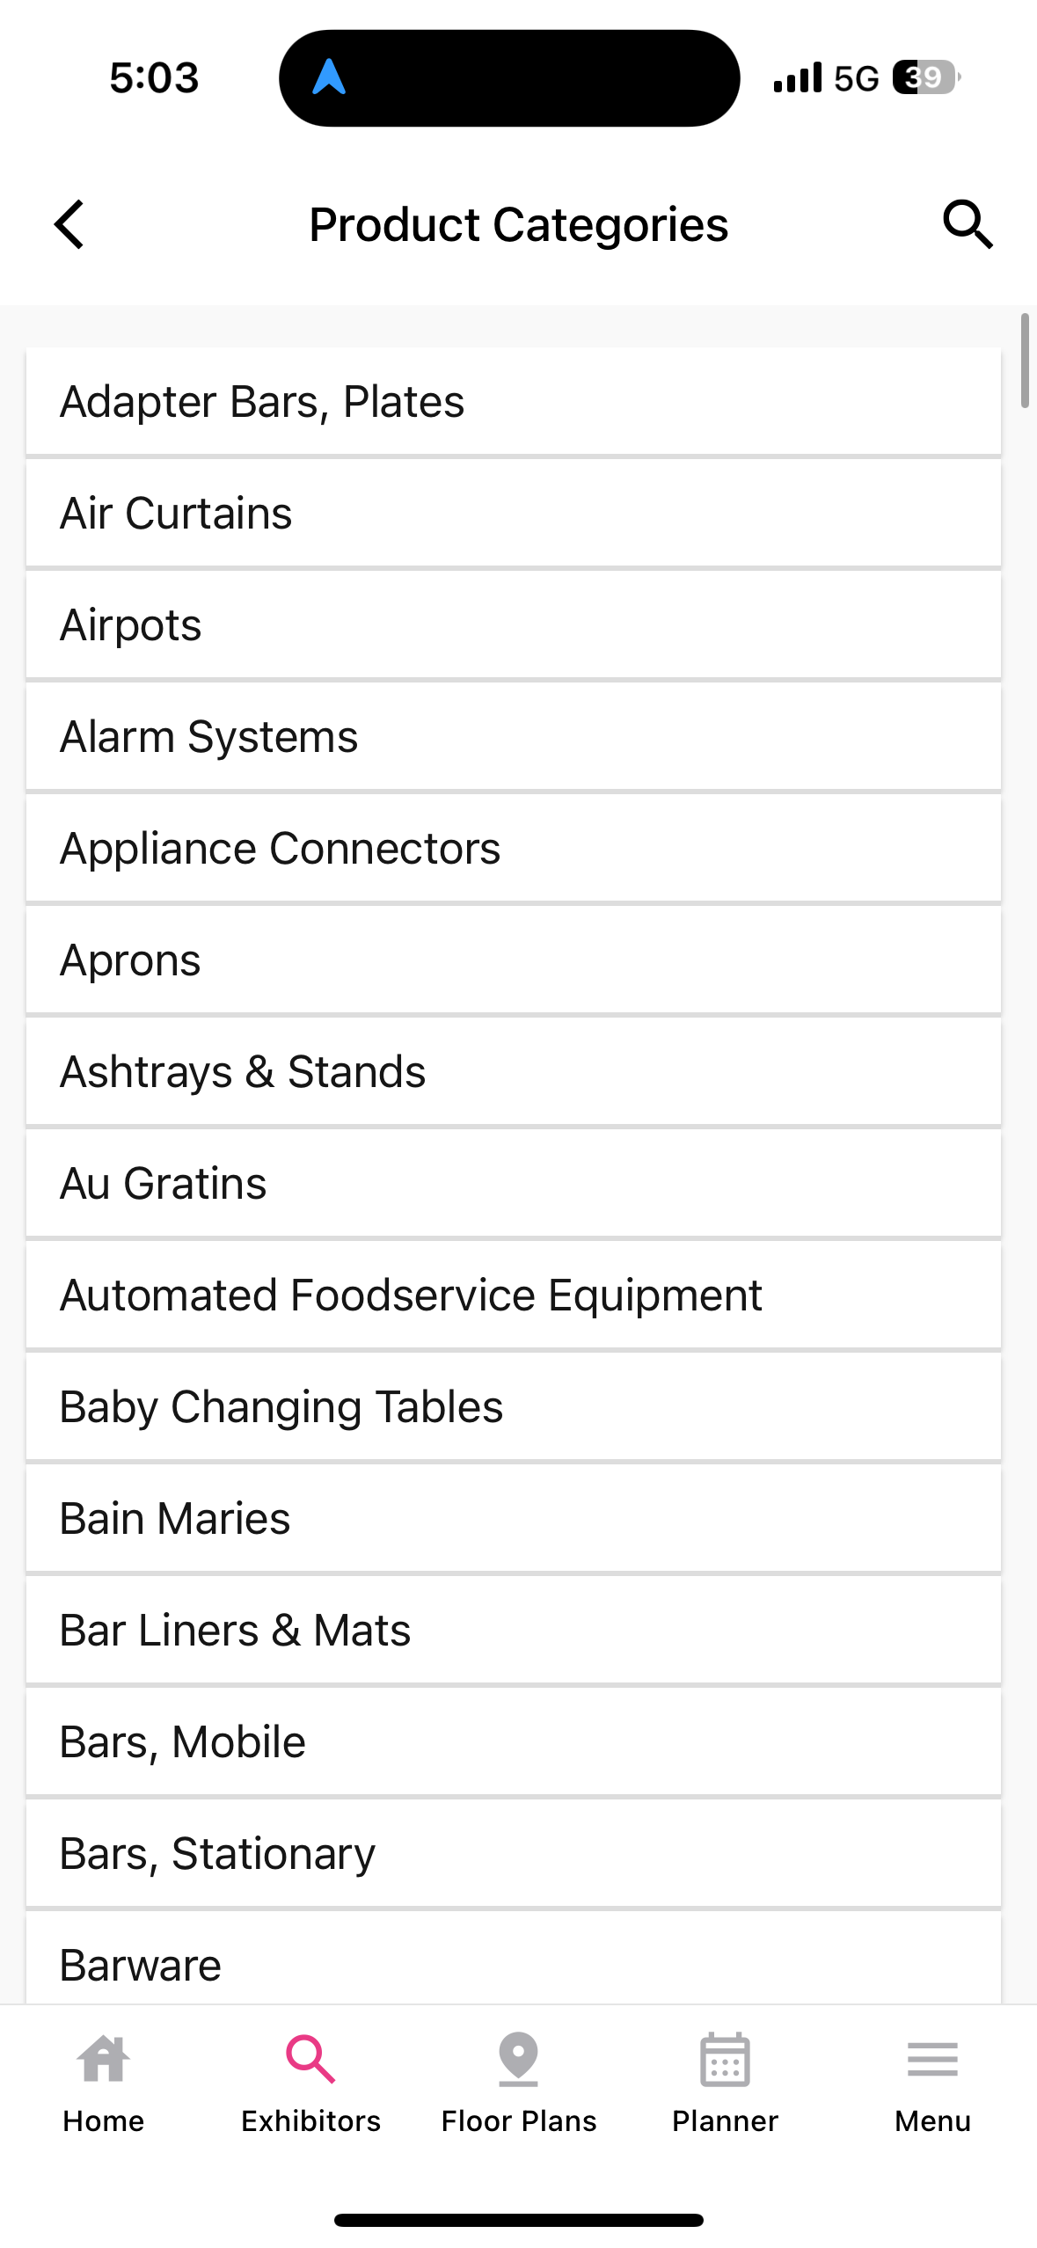
THE NAFEM SHOW APP

Slide 30
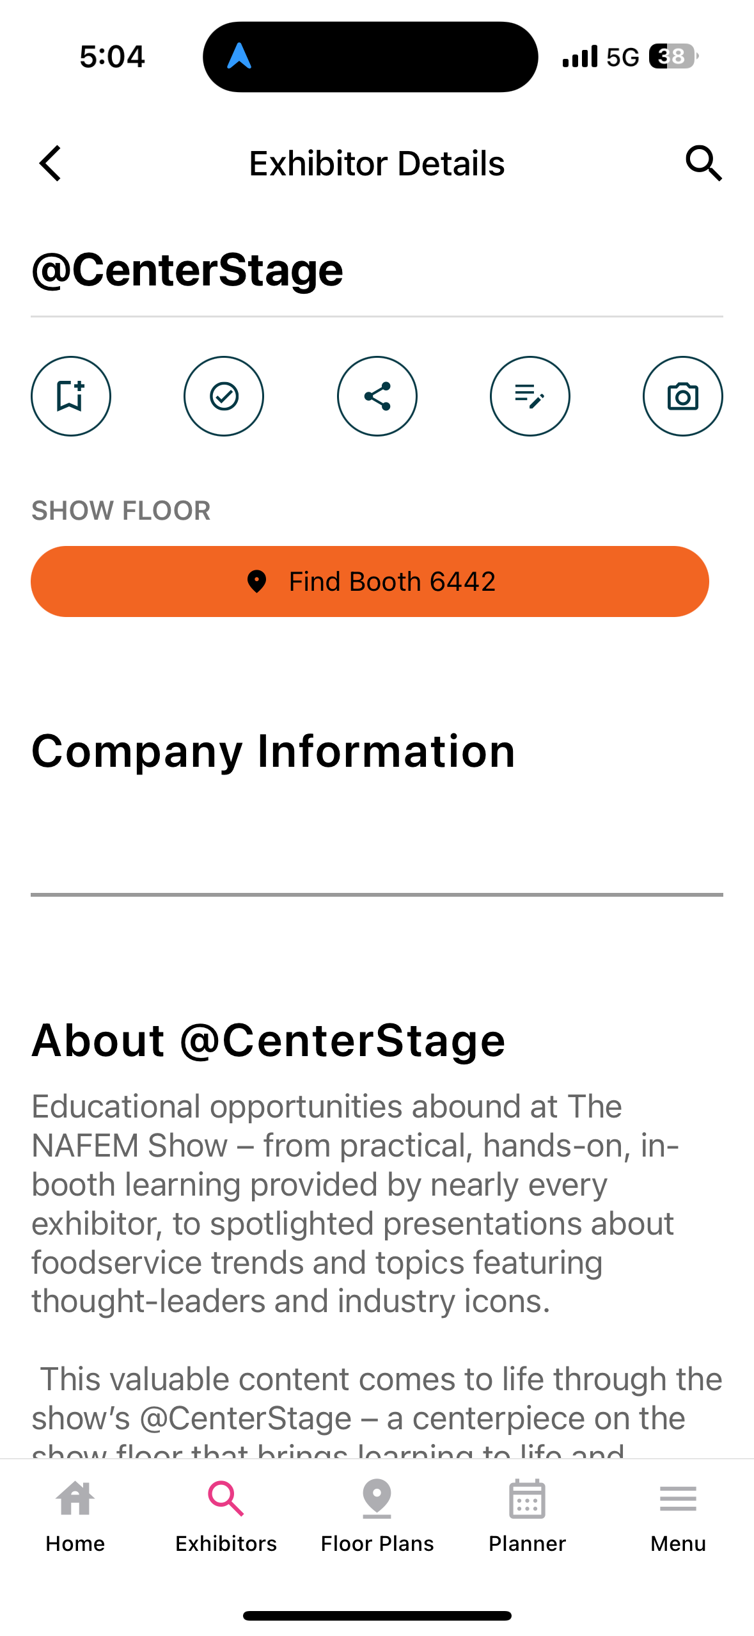
THE NAFEM SHOW APP

Slide 31
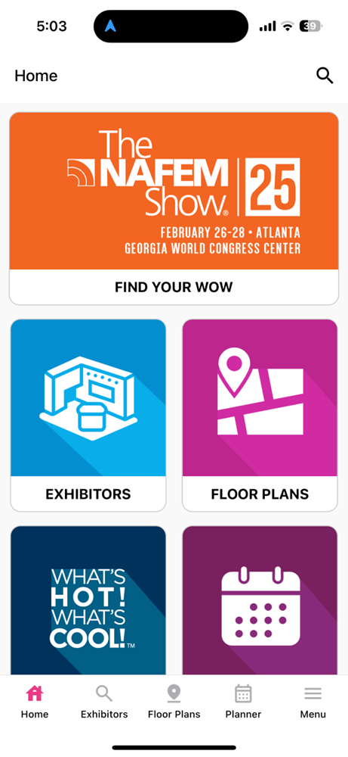
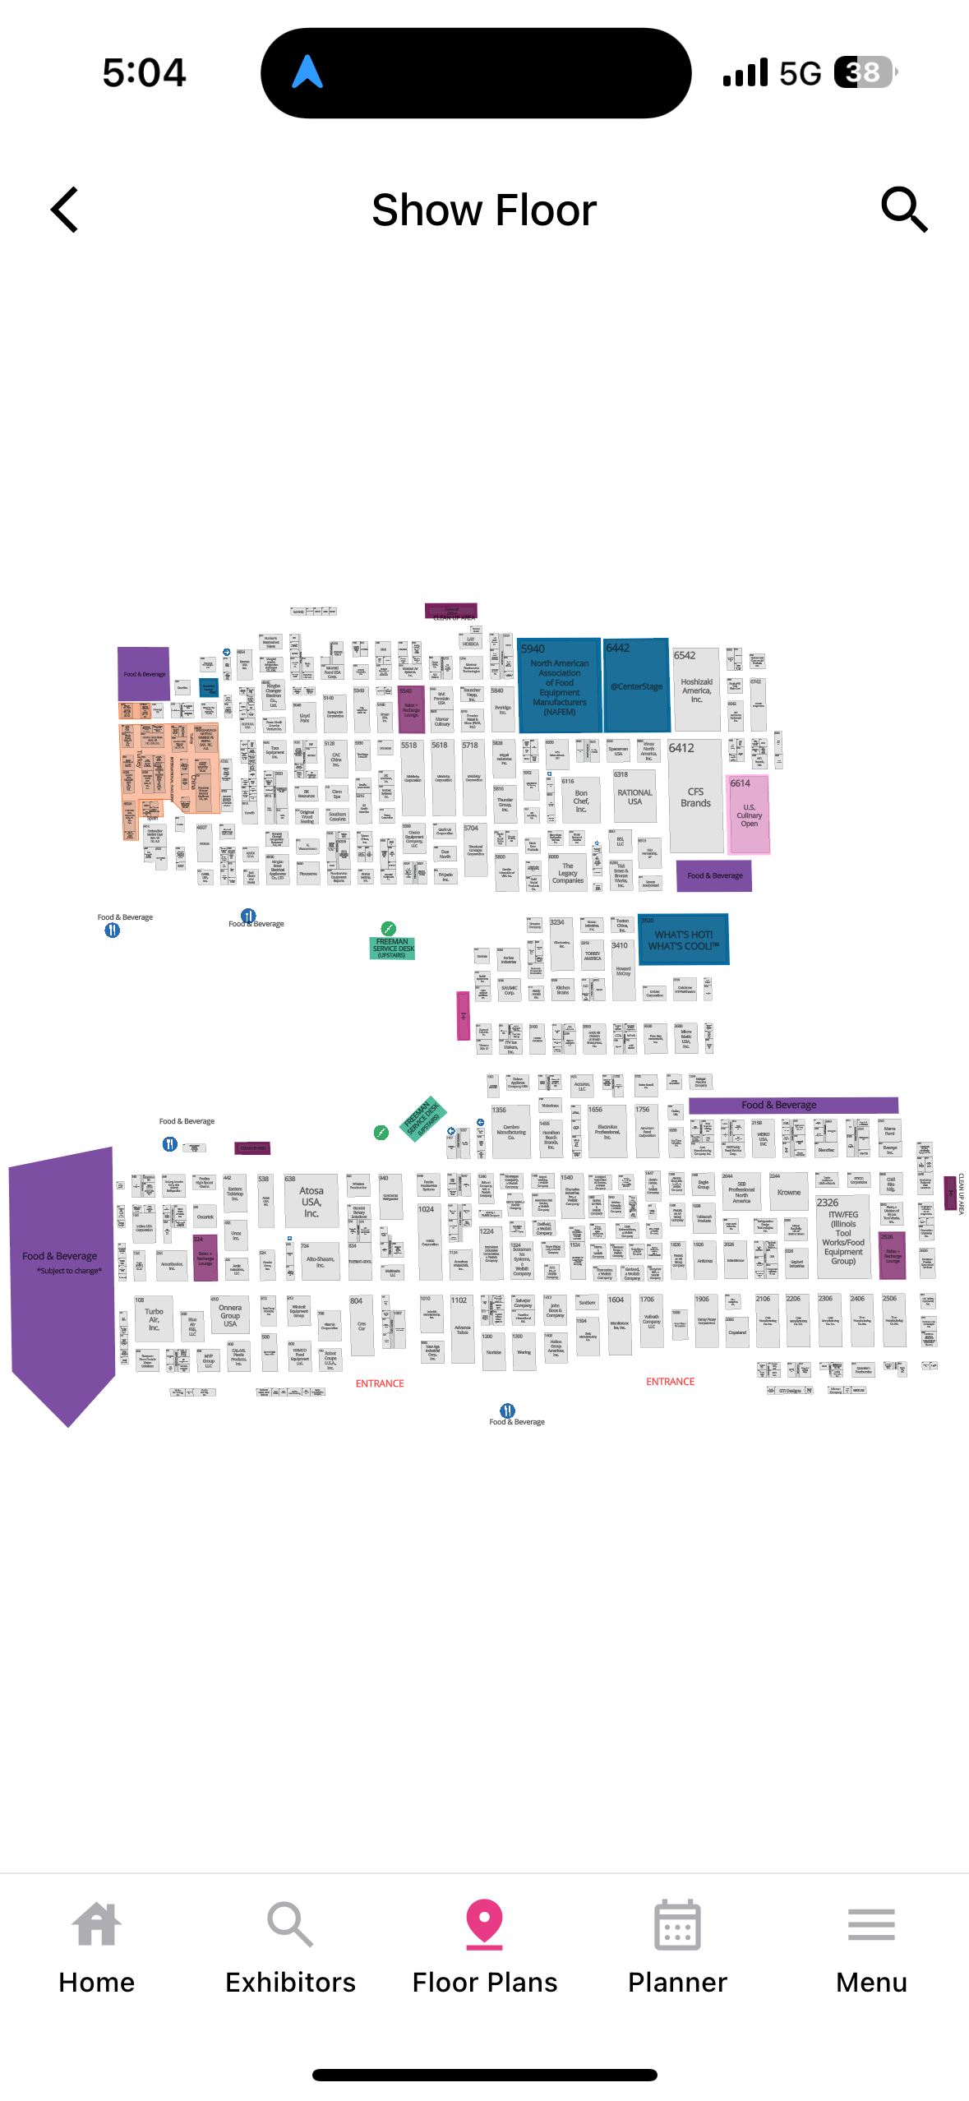
THE NAFEM SHOW APP
Exhibit Hall Floorplan
WHAT’S HOT! WHAT’S COOL!™ products
Schedule of Events
List of all education sessions in @CenterStage
New product showcase
Attendee general information
Shuttle bus schedule
Local info (nightlife)
Social media

Slide 32
THE NAFEM SHOW APP
Two steps to create your profile
1. My Show Planner icon
Create your show account (link to badge ID)
2. Networking icon
Networking settings
“Chat With Attendees” – select “Yes”

Slide 33
WHILE IN ATLANTA

Slide 34
DINING
NAFEM Show Mobile App
Concessions options at convention center
Locations, menus, pricing, hours of operation
Discover ATL stationed at the NAFEM the info desk and able to assist with restaurant information, reservations and city of Atlanta information.
Location: Building B Entrance Hours: Tuesday, Feb. 25 8 a.m. - 8 p.m. Wednesday, Feb 26 7 am - 5p.m. Thursday, Feb. 27 7 am - 5 p.m. Friday, Feb. 28 7 a.m. - 3 p.m.

Slide 35
TRANSPORTATION
Airport = Super Shuttle, taxis, Uber/Lyft
Convention Center District – taxis, Uber/Lyft
Hotel shuttle provided by NAFEM to/from hotels and convention center
Except for walkable hotels: Omni, Signia by Hilton, Embassy Suites Centennial Olympic Park, Hilton Garden Inn and
Hyatt Place

Slide 36
SOCIAL MEDIA
Follow us on social media:
/TheNAFEMShow
@TheNAFEMShow
@thenafemshow, @nafemhq
North American Association of Food Equipment
Manufacturers (NAFEM)
Share your photos during the show with #TheNAFEMShow #NAFEM25

Slide 37
A WORD ABOUT SAFETY

Slide 38
Downtown Atlanta Ambassador Force (Red Coats)
Assist everyone visiting, living, working or studying in Downtown Atlanta
Patrol streets of Downtown Atlanta on foot, bicycle, Segway, ATV
Emergency Assistance
Escort you or contact police if help is needed
Help you find your destination
Recommend restaurants and entertainment
Main information booth at Andrew Young International Blvd. & Peachtree Street
Call: +1.404.215.9600
Text: +1.404 732.4200

Slide 39
NEED HELP?
www.thenafemshow.org
info@thenafemshow.org
+1.312.245.1054
Show app
Ask Ginger

Slide 40
QUESTIONS?

Slide 41
THANK YOU

