Slide 1
Be a good booth neighbor and avoid onsite booth violations
October 9, 2024
Notes:
Good afternoon!
Welcome to the third in our series of educational webinars –
Be a good neighbor and avoid onsite booth violations
My name is Jackie Janus, and I’m the Senior Exhibits Manager with The NAFEM Show. I’m also joined by my colleague, Kelsey Kwasniak, Senior Exhibits Coordinator.
As noted, this is the third webinar in our educational series.
During the next few months, we’ll present webinars on topics we think you’ll find useful.
To find out what we have scheduled, take a look at thenafemshow.org – Resources/exhibitor education section of the website, and sign up.
A couple of reminders about the show –
The NAFEM Show dates are February 26-28, 2025 at the Georgia World Congress Center, in Atlanta, GA.
Show days are Wednesday-Friday with a Kick-Off Party on Tuesday evening.
The NAFEM Party is at The Mercedes-Benz Stadium on Thursday, Feb. 27 from 7-11.
Now about today’s webinar –
All webinars are recorded and are available to you in the Exhibitor education section of the show website at thenafemshow.org.
If you have questions during today’s webinar, please send them to us
by using the “Q&A” function in your Zoom Webinar control panel.
We’ll answer everything we can. If we run out of time or don’t
get to your question, we’ll get back to you as soon as possible after the webinar with the information you need.
If you have a question specific to your company and booth layout, please send us an email at info@thenafemshow.org and our team can assist you further.
With that… I am going to turn it over to Kelsey to talk about what you came here to hear – Be a good booth neighbor and avoid onsite booth violations. Kelsey, take it away!
***EVERYONE TURNS OFF CAMERAS***

Slide 2
AGENDA
Booth Types, Common Violations, and Violation Examples
Booth Diagram Submission
Booth Signage & Display Rules
Booth Violation Notices
Important Dates
Q&A
Notes:
[Kelsey] Great, thank you Jackie and thank you all for joining us today! You’ll see our agenda shown here including reviewing booth types, common violations and examples, how to submit your booth diagram, signage details and finally we’ll wrap up with important dates and Q&A.
As you can see we’ll cover quite a few topics today so let’s get started!

Slide 3
EMAIL COMMUNICATION
Email sent to all trade show contacts on 10/7
Email includes booth rules and regulations based on your booth type to review.
Targeted Move-In Floor Plan included
Accessed via the Exhibitor Resource Center
Notes:
[Kelsey]
Please note that all trade show contacts received an email on Monday, October 7 this week which included specific rules and regulations based on your booth type. We will also review these details today. This email also included our targeted move-in floor plan which is accessible via the Exhibitor Resource Center.

Slide 4
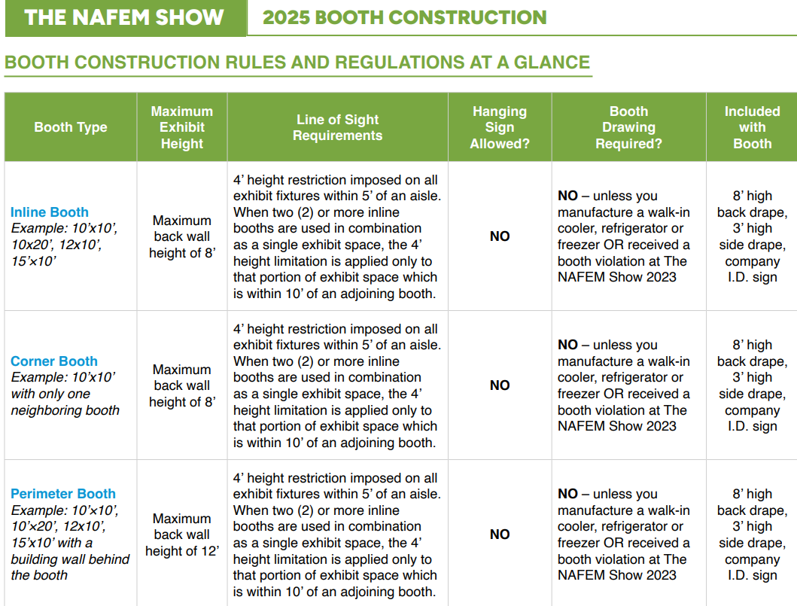
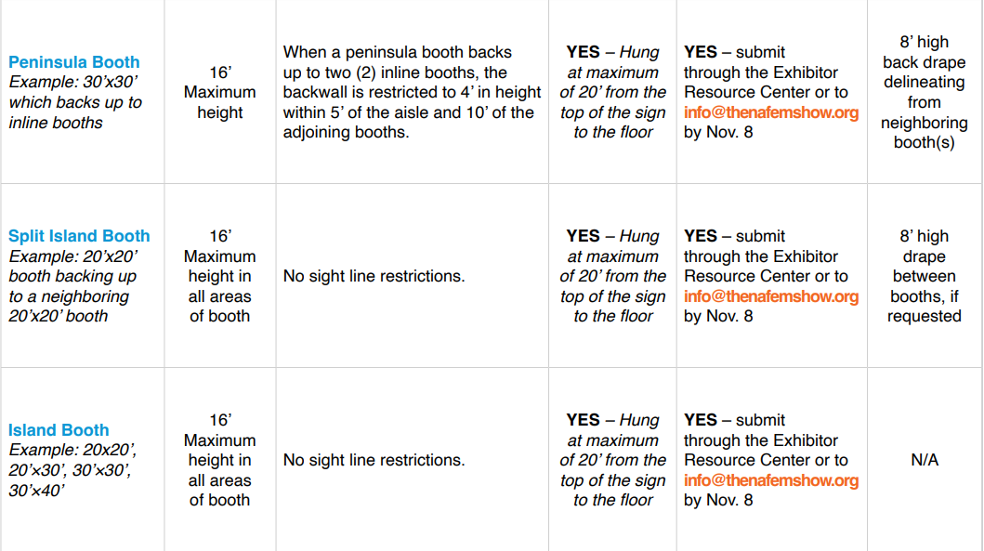
RULES & REGULATIONS
2025 Rules & Regulations
Notes:
[Kelsey]
Before we get started with specific booth types, I wanted to reference that everything we’re covering today can also be found within The NAFEM Show 2025 Rules & Regulations which is found in the Exhibitor Resource Center or on The NAFEM Show website. I’ve included a screenshot here of our rules at a glance broken down by booth type. The rules and regulations also include diagrams and further details depending on your booth type. If you’re unsure on what type of booth you have, please don’t hesitate to email info@thenafemshow.org and our team is happy to assist!
With that being said, let’s begin by covering each specific booth type.

Slide 5
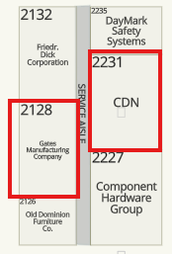
INLINE BOOTHS
Exhibit fixtures should not obstruct sight lines of neighboring exhibitors.
Maximum of 8’ in the rear of the exhibit space.
Maximum of 4’ in the front 5’ of your booth within 10’ of a neighboring booth.
Hanging signs NOT permitted.
Notes:
[Kelsey]
At The NAFEM Show, we have (6) types of booths– inline, corners, peninsulas, perimeter, split island and island booths.
Starting with inline booths – they only have one side exposed to an aisle and are generally arranged in a series along a straight line. Individual booths may be combined to form a larger inline exhibit space.
In the first example shown on the screen, Foodservice Sustainability Solutions is a 12x20 inline space. Next to them is Atlanta Booth & Chair which is another 12x20 inline space.
In the example to the right, you see two rows of inline booths. The space between indicates the service aisle. The service aisle is behind the booth space and attendees cannot walk in that area. The service aisle will be hidden with 8’ drape.
In all inline booths, exhibit fixtures should not obstruct sight lines of neighboring exhibitors. This means that there is a maximum height of 8’ in the back of the exhibit space and a maximum of 4’ in the front 5’ of your booth that’s within 10’ of a neighboring booth.
**POINT ON SCREEN TO SHOW WHERE YOU CAN GO UP TO 8’ and 4’
Hanging signs are NOT permitted in inline booths.
I want to point out that island booths can build up to 16’ in all areas of their booth. This is something to be aware of if you have island booths near your inline booth.

Slide 6
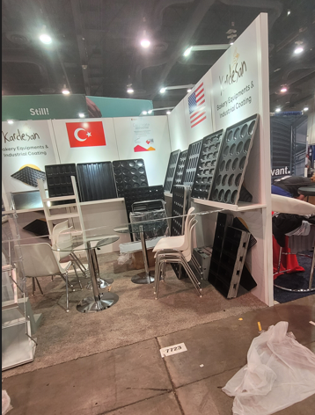
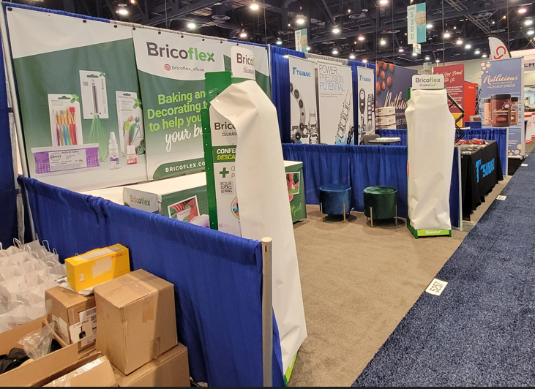
INLINE VIOLATION EXAMPLE
Notes:
[Kelsey] This is an example of an inline booth that has items in their booth taller than 4’ tall in the front 5’ of their booth. As you can see, they are blocking their neighbors sightlines. Starting in this area of their booth *POINT TO AREA* they should not be any taller than 4’. The same violation is here but the exhibitor has an 8’ wall on the side of their booth which completely blocks their neighbor. Both examples here would be booth violations.

Slide 7
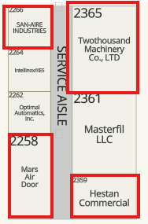
CORNER BOOTHS
Exhibit fixtures should not obstruct sight lines of neighboring exhibitors.
Maximum of 8’ in the rear of the exhibit space.
Maximum of 4’ in the front 5’ of your booth within 10’ of a neighboring booth.
Hanging signs NOT permitted.
Notes:
[Kelsey] Corner booths are the same shape as an inline booth, but these booths have two sides exposed to an aisle. You’ll see in the red rectangles shown here examples of corner spaces.
In corner booths, the same rules apply as inline booths. Exhibit fixtures should not obstruct sight lines of neighboring exhibitors. This means that there is a maximum height of 8’ in the back of the exhibit space and a maximum of 4’ in the front 5’ of your booth within 10’ of a neighboring booth.
**POINT ON SCREEN TO SHOW WHERE YOU CAN GO UP TO 8’ and 4’
Hanging signs ARE NOT permitted in corner booths.

Slide 8
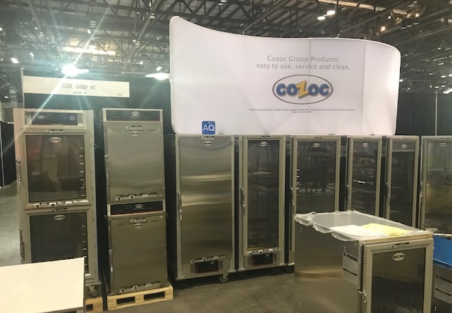
VIOLATION EXAMPLE
Notes:
[Kelsey] This exhibitor has a corner booth, but their sign on top of their equipment is over 8’ tall. As a reminder, nothing can be taller than your 8’ tall drape in the back of your booth.

Slide 9
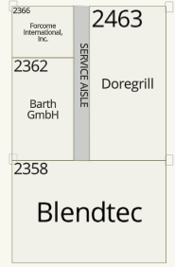
PENINSULA BOOTHS
Open on three sides with inline booths behind it.
Backwall is restricted to 4’ in height within 5’ of the aisle and 10’ of the adjoining booths.
Backwall side that faces inline booths must be finished and cannot contain copy/branding.
Hanging signs permitted.
Notes:
[Kelsey] Peninsula booths are exposed to aisles on three sides and composed of a minimum of four booths. Backwalls must be finished and cannot contain any branding or copy. Finished means that there can be no exposed wood or material.
When a peninsula booth backs up to two inline booths, the backwall is restricted to 4’ in height within 5’ of the aisle and 10’ of the adjoining booths. 16’ (4.88m) is the maximum height allowance for the center portion of the backwall and exhibit fixtures.
Hanging signs can be hung at a maximum height of 20’ (6.10m) to the top of the sign. If hanging sign is placed within 5’ (1.53m) of an adjacent booth, the side facing the adjacent booth should be finished and not contain any copy.
NAFEM will provide 8’ high drape for all peninsula booths.
In the example here, Blendtec is a 30x20 peninsula space and cannot go taller than 4’ in this area *POINT* and this area *POINT*. They can have a hanging sign but if it is within 5’ of their neighbor booths it cannot have copy facing the neighbors.

Slide 10
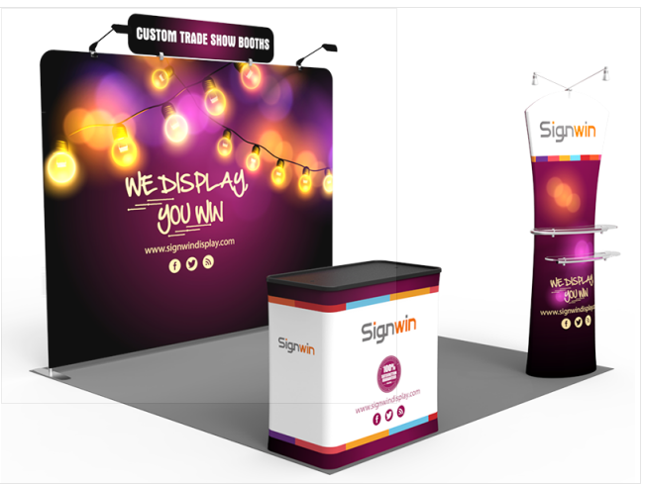
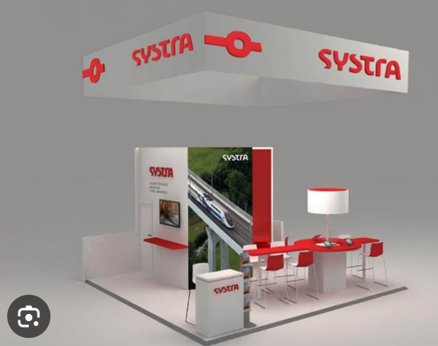
PENINSULA VIOLATION EXAMPLE
Violation Example
Peninsula Booth with proper display
Notes:
[Kelsey] This is an example of an inline booth that has items in their booth taller than 4’ tall in the front 5’ of their booth. As you can see, they are blocking their neighbors sightlines. Starting in this area of their booth *POINT TO AREA* they should not be any taller than 4’. The same violation is here but the exhibitor has an 8’ wall on the side of their booth which completely blocks their neighbor. Both examples here would be booth violations.

Slide 11
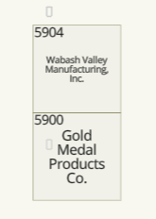
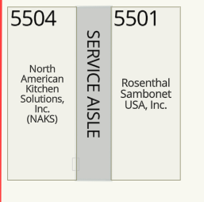
ISLAND BOOTHS
16’ in all areas.
Hanging sign permitted.
Split island back wall must be finished and cannot contain copy.
Notes:
[Kelsey] We have two types of island booths– an island that is open on all four sides, like Franke Foodservice or Hatco as you see on the left, and a split island that is open on three sides, like Wabash Valley Manufacturing and Gold Medal Products. Regardless if you are an island or split island booth, you can build up to 16’ in all areas of your booth and have a hanging sign at a maximum of 20’ from the floor to the top of the sign.
If you have a split island booth and have a back wall, the side that faces the neighboring exhibitor must be finished and cannot contain copy. For example, if Wabash put up a 16’ wall right here *POINT* the side that faces Gold Medal cannot have copy or logos and must be cleanly finished. As a reminder, finished means that there is no exposed wood or materials and is fully painted/finished for display.
Island booths are a minimum of 20 feet by 20 feet. This means that if your booth is smaller than 400 square feet you are not considered an island. NAKS and Rosenthal in the example shown here are smaller spaces and face out so they are considered double corner spaces and must follow those rules rather than island booth rules.
If you have a multi-level booth, the Georgia World Congress Center needs an engineered stamp plan for your structure to be approved. This means that NAFEM will review your diagram to ensure it’s following show rules and regulations and then you will need to re-submit to GWCC for additional approval. This also applies for anyone cooking in their booth. These forms and details can be found in the Exhibitor Resource Center.

Slide 12
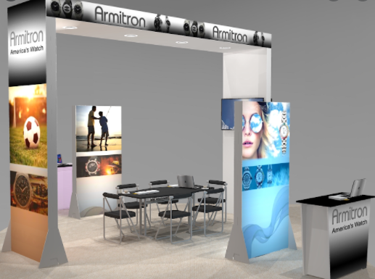
ISLAND VIOLATION EXAMPLE
18’
Notes:
[Kelsey] This island booth space has a structure that is above 16’ tall. Your hanging sign can hang at 20’ from the floor to the top of the sign, but any booth structures have a maximum height of 16’.

Slide 13
BOOTH DIAGRAMS
The following NAFEM Show Exhibitors are required to submit a detailed floor plan, including dimensions, to Show Management for review and approval by Friday, Nov. 8.
Island Booth
Split Island Booth
Peninsula or Modified Peninsula
Companies who received a written booth violation at The NAFEM Show 2023
Companies who manufacturer walk-in coolers, refrigerators and/or freezers
Submit your drawing through your Exhibitor Resource Center and NAFEM Show Management will respond in the ERC portal with approval or the request for more information.
Notes:
[Kelsey] The NAFEM Show Exhibitors occupying an Island, Split Island, Peninsula, Modified Peninsula, received a written booth violation at The NAFEM Show 2023 or who manufacturer walk-in coolers, refrigerators and/or freezers are required to submit a detailed floor plan, including dimensions, to Show Management for review and approval by Friday, Nov. 8.
Booth diagrams are submitted directly via the Exhibitor Resource Center for approval. Our team will provide approval directly in the ERC so you’re team will know if your diagram has been approved or denied. If NAFEM needs more detail or a revision to your diagram, your submission will be declined and you will receive an email with what needs to be revised in order for NAFEM to provide approval.
If you are not required to submit a booth drawing but you have questions for show management or just want to double check your layout, feel free to also submit a drawing and we will get back to you with any feedback.
As a reminder, NAFEM does not provide official approval via email – all diagrams must be submitted via the Exhibitor Resource Center. If you have questions before submitting, you can certainly do so by emailing info@thenafemshow.org.

Slide 14
BOOTH SIGNAGE & DISPLAY RULES
All booth items such as products, literature, pens, shirts, etc., may display the Exhibitor’s logo. Reference or logos of a distributor, dealer or supplier cannot be present in the booth.
An Exhibitor may list its NAFEM member company name and brands on booth signage and graphics.
All products exhibited must be on NAFEM’s Approved Product Category List.
An exhibitor may display a product which it does not manufacture, only if the products are branded under its name or trademark. The brand may be shown on the product or its packaging.
Notes:
[Kelsey] For signage, all booth items such as products, literature, pens, shirts, etc., may display the Exhibitor’s logo. Reference or logos of a distributor, dealer or supplier cannot be present in the booth.
An Exhibitor may list its NAFEM member company name and brands on booth signage and graphics.
As for products, all products exhibited must be on NAFEM’s Approved Product Category List.
An exhibitor may display a product which it does not manufacture, only if the products are branded under its name or trademark. The brand may be shown on the product or its packaging.
If you have a question about products or graphics you would like to have in your booth, please reach out to info@thenafemshow.org and we will confirm if it is permitted.

Slide 15
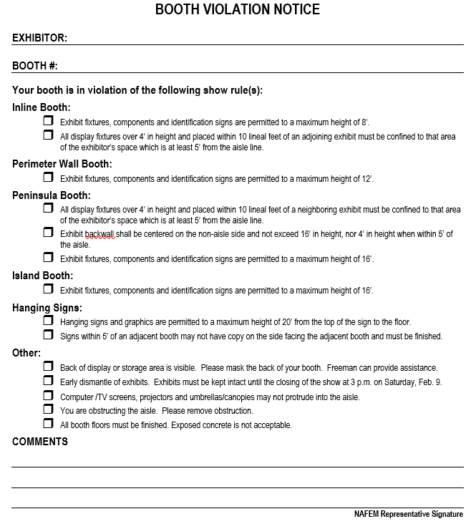
VIOLATION NOTICES
How are these rules enforced?
What happens if I have a booth violation at the show?
Notes:
[Kelsey] The NAFEM Show is divided up into sections, each with a floor manager assigned to it. They are there to help exhibitors and answer questions and also to keep an eye out for booth violations. If the floor managers see a violation, first they have a conversation with the exhibitor to explain the violation so that the exhibitor can adjust their booth structure. If the exhibitor is not in their booth they are given a written violation notice. We review all violations with exhibitors on Wednesday, the morning of show opening to confirm they have been resolved so that the violation can be removed.
If the violation remains intact at the time of show opening on Wednesday, the exhibitor may, at the discretion of NAFEM, lose part or all of their priority points, and may entirely lose the privilege of exhibiting in future NAFEM Shows.

Slide 16
IMPORTANT DATES
Nov. 6
Webinar #4 – Everything You Need to Know as a First Time Exhibitor
Nov. 8
Detailed floor plans due for exhibitors occupying an island, split island, peninsula, or modified peninsula booth; manufacturers of walk-in coolers, refrigerators and/or freezers; or those with written booth violation notices from 2023
Hanging signs are permitted to a maximum height of 20’ to the top of the sign.
Notes:
Detailed floor plans are due on November 8th for any exhibitor who has an island, split island or peninsula booth, as well as Exhibitors who manufacturer walk-in coolers, refrigerators or freezers. Please note that for any booth configuration eligible to have a hanging sign such as an island booth, NO hanging signs are permitted to be rigged over an aisle. Your hanging sign MUST be rigged over the confines of your contracted booth space. If you received a booth violation at the 2023 show, then you are also required to submit detailed floor plans by November 8th. As mentioned earlier, you will submit your diagram for approval via the Exhibitor Resource Center.

Slide 17
IMPORTANT DATES
Dec. 11
Webinar #5 – Exhibitor Registration, Lead Retrieval and Booth Promotions
Jan. 10, 2025
Last day to submit contracts and company name changes
Ongoing
Exhibitor education webinar & video series
https://www.thenafemshow.org/

Slide 18
Q&A
info@thenafemshow.org
Notes:
[Kelsey]
With that, I’ll have Jackie hop back on and we’ll begin Q&A. If our team does not address your questions live here today, we will note all questions and get back to you individually following the webinar.
Q&A
[Jackie] Thanks. Now let’s get to the questions …
Keep in mind if you do have a specific question, please email info@thenafemshow.org and our team can assist you further.
(Field Questions)
Seeded questions:
How do I determine which booth rules to follow if I’m unsure on my booth type?
If I check with my neighboring company can I build higher or block their line of sight if they’re okay with it?
CLOSE
2:45 p.m. –Q&A ends; Jackie closes
Reminder….A recording of today’s webinar will be posted by tomorrow for reference on the nafem show site.
If you haven’t already, sign up for the next webinar taking place on Nov. 6 at 2 p.m. central for Everything You Need to Know as a First Time Exhibitor.
That’s it! Thanks for joining us. Have a great rest of your day!

Slide 19
THANK YOU

